Slide 1






LIBRARY MANAGEMENT SYSTEM
Presented by :
Abdelrahman ASHRAF (320220168)
RASHA GAMEL (320220165)
YOUSSEF MAGED (320220177)
Gina Sobhy (320220162)
Mark Michael (320220212)
Presented To :
DR. Ahmed antar

Slide 2

Outline
Overview
User Characteristics
Login Page
Home Page
Manage Users
Add/View/Update/Delete User
Books
Add/View/Update/Delete Book
Transaction
Receive Book/Issue Book

Slide 3
Overview
This project, the "Library Management System," was chosen to automate and streamline library transactions, addressing the inefficiencies of traditional manual systems. The scope involves monitoring and controlling library operations to enhance efficiency and record-keeping.
Recognizing the challenges in current library management, we decided to computerize the system after conducting a feasibility study. The primary objective is to create a user-friendly interface, minimizing manual efforts and improving overall efficiency.

Slide 4

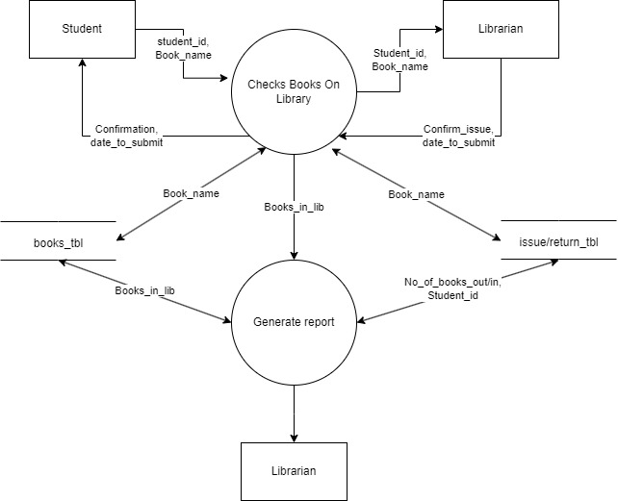



How our system works:

Slide 5
User Characteristics
In the administration side of the "Library Management System," the following sub-modules are performed:
Add Students Detail:
This module involves the addition of student details to the system, facilitating comprehensive records of library users.
Add Books Detail:
The administration side allows for the addition of book details, ensuring an updated inventory of the library's collection.
Search User/Book:
Enables the search functionality for both users and books, enhancing accessibility and retrieval of information.
Issue Book to any Student:
Facilitates the issuance of books to students, ensuring a systematic and tracked process for book lending.
Receive Returned Book:
Handles the return process of books, updating the system with the returned status and maintaining accurate records.
Maintaining Student/Book Details:
This module involves the overall maintenance of student and book details, ensuring data accuracy and system integrity.

Slide 6

Login Page
The provided login page serves as the gateway for admin authentication and comprises the following components:
Username:
The entered username undergoes verification against the database records.
Password:
The entered password undergoes verification against the stored database credentials.
Login Button:
Clicking on the Login button initiates the authentication process, allowing access to the software for verified admin users.
It is crucial for users to input the correct combination of both username and password to ensure successful authentication. Additionally, the system is case-sensitive, requiring an exact replication of the sentence case employed during the registration process for accurate verification. Any deviation in the case of either the username or password may result in improper authentication. Therefore, meticulous adherence to the original case configuration stored in the database is essential for a seamless and secure login experience.

Slide 7

Home Page
This Home page is to perform multiple functionalities which includes.
User : User Button is to Add/View/Update/Delete Users.
Book Categories : Book Categories Button is for Add/Update/delete Book Categories.
Book : Book Button is to Add/View/Update/Delete Books.
Transaction: Transaction Button is for Issuing/Returning Books.
Borrower : Borrower Button is for Add/View/Update/Delete Borrowers.

Slide 8
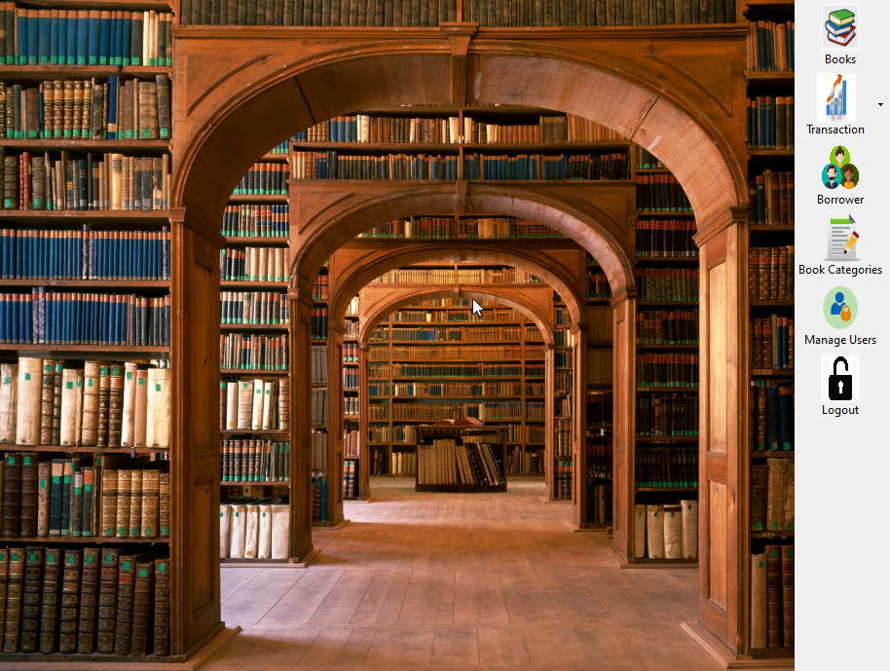
Home Page(Continue..)

Slide 9

User Functionality:
We have implemented various functionalities in this project:
Add User
View User
Update User
Delete User

Slide 10
Book Functionality:
We have implemented various functionalities in this project. From my side of contribution, I have implemented Complete Book functionalities which includes which includes:
Add Book
View Book
Update Book
Delete Book
Search Book

Slide 11

Issue Book Functionality:
We have implemented all functionalities on admin side. Admin can issue to user. Following are some conditions:
Maximum 1 of The same book issued to one user at a time.
User Has to Return the book to borrow it again.
Admin can see the count of Books Issued for each user by entering the User-ID.

Slide 12

Return Book Functionality:
User Provide His ID if He Wants to Return the Book That Has Been Previously Issued to Him/Her. Admin Enter his User ID and Search for His Record. If the Record is Found, then He Can Return the Book by Clicking Return Book Button.
Admin can see the count of Books Returned for each user by entering the User-ID.

Slide 13
Thank You

